Slide 1
Lead Scoring
Educational Lead Conversion

Slide 2
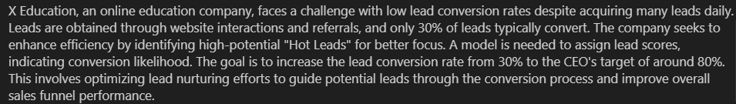
Problem Statement

Slide 3
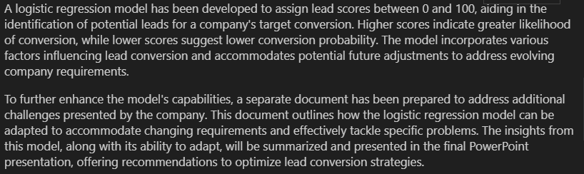

Slide 4
Steps involved for Solving problem
1) Reading and Understanding the dataset
2) Exploratory Data Analysis
3) Pre-processing the data for Model Building
4) Building the Model
5) Evaluating the Model
6) Making predictions on the test set
7) Handling different scenarios in Documents

Slide 5
1) Reading and Understanding the dataset

Slide 6
Information of dataset
Shape:
9240 rows and 37 columns
30 Columns with data type as Object
4 Columns with data type as float64
3 Columns with data type as int64

Slide 7
Target Variable – Converted (Categorical)
Value 1 means lead is converted successfully
Value 0 means lead is not converted successfully
There are around 38% values for which value of converted is 1 and 62% values for which value of converted is 0.
So, the data is nicely balanced for performing analysis

Slide 8
2) Exploratory Data Analysis

Slide 9
2) Exploratory Data Analysis - Steps
1) Dropping Columns and Handling Outliers for Categorical Columns
2) Analysing Numerical Columns and Checking Outliers
3) Univariate Analysis
4) Bivariate Analysis
5) Multivariate Analysis

Slide 10
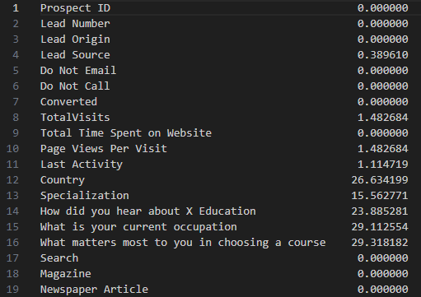
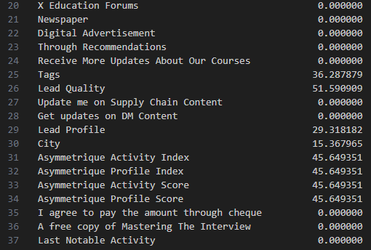
1) Dropping Columns – Null Values

Slide 11
1) Dropping Columns – Null Values
There are total 6 columns from total of 37 columns for which missing value percentage is more than 35%. All those columns are dropped.
Dropped 6 columns are:
Asymmetrique Profile Score
Asymmetrique Activity Index
Asymmetrique Profile Index
Asymmetrique Activity Score
Tags
Lead Quality

Slide 12
Country Column - Dropped
There are around 26% null values in this column and of the remaining 74% values, around 96% country value is India. So, there is high imbalance in the data.
And column named City is present in the data which gives idea about the geographical location.
So, the column country is removed from the data as it doesn’t provide any significant information.

Slide 13
Prospect ID and Lead Number - Dropped
Both columns Prospect ID and Lead number are like unique Identifier for each row. Thus, it has different value for every record in the data.
There are not any feature which can change the value of target variable. So, both columns are dropped from the analysis.

Slide 14
Do Not Call Column - Dropped
There are only 2 values for which value of “Do Not Call” is Yes and all the other values are No.
So, this column has very high imbalance and as there are only 2 Yes values compared to huge number of records. It doesn’t provide any significant insights for the analysis.
So, the column “Do Not Call” is dropped from the analysis.

Slide 15
How did you head about X Education - Dropped
There are around 4800+ values as “Select” for this column, which means user hasn’t provide any information for this.
When all the null values are replaced with “Select” for this column and then total number of “Select” value is counted, it is turned out that there are around 78% Select values in the column.
78% null value in this column is very high percentage. So, this column is dropped from analysis.

Slide 16
What matters most to you in choosing a course - Dropped
There are around 6300+ points for which value is “Better Career Prospects” and there are only 3 types of values. Other value like ‘Flexibility & Convenience’ and ‘Other’ have occurred only 1 times each. And other records has null values.
So, there is high imbalance in this column and it doesn’t hold much importance for the analysis.
So, this column is dropped.

Slide 17
Search, Magazine, Newspaper Article, X Education Forums, Newspaper, Digital Advertisement - Dropped
There are mostly ‘No’ values in all these sources and very few Yes values with maximum as 14 for Search column, which is very low compared to the original size of the dataset.
So, all these columns can be dropped as combined Yes from all these columns is very less compared to size of the data.

Slide 18
Through Recommendations - Dropped
There are only 7 ‘Yes’ values compared to more than 9000+ ‘No’ values for this column.
As there is high imbalance in this column and it doesn’t provide much important information, it is dropped from the analysis.

Slide 19
Receive More Updates About Out Courses - Dropped
There are all ‘No’ values in this column and there is 0 ‘Yes’ value for this column.
This column doesn’t provide any useful information for the analysis and hence it is dropped from the analysis.

Slide 20
Update me on Supply Chain Content and Get updated on DM Content - Dropped
There are all ‘No’ values in both these columns and there is 0 ‘Yes’ value in both these columns.
These columns don’t provide any useful information for the analysis and hence they are dropped from the analysis.

Slide 21
I agree to pay through the amount through cheque - Dropped
There are all ‘No’ values in this column and there is 0 ‘Yes’ value for this column.
This column doesn’t provide any useful information for the analysis and hence it is dropped from the analysis.

Slide 22
Handling Outliers for Categorical Columns
Do Not Email column
For this column, there are 8400+ ‘No’ values and around 700+ ‘Yes’ values.
There is imbalance in Yes and No values but more than 700+ Yes values may provide significant information for analysis of the data.
So, there are no outliers in this column

Slide 23
Lead Source
There are very few number of observations (1 or 2) compared to original datasize for many categories in Lead Source which will lead to more number of variables for analysis, when dummy variables will be created from it. So, records with those categories are dropped whose count is less than 10.
Value | Counts
Google | 2873
Direct Traffic | 2543
Olark Chat | 1755
Organic Search | 1154
Reference | 534
Welingak Website | 142
Referral Sites | 125
Facebook | 55

Slide 24
Last Activity
Value | Count
Email Opened | 3422
SMS Sent | 2720
Olark Chat Conversation | 972
Page Visited on Website | 634
Converted to Lead | 426
Email Bounced | 321
Email Link Clicked | 267
Form Submitted on Website | 116
Unreachable | 93
Unsubscribed | 58
Had a Phone Conversation | 30
There are very few number of observations (<10) compared to original datasize for many categories in Last Activity which will lead to more number of variables for analysis, when dummy variables will be created from it. So, records with those categories are dropped whose count is less than 10.

Slide 25
Specialization
There are 1942 datapoints which has value ‘Select’ which is equivalent to null. So, all null values are replaced with ‘Select’.
There are around 36% null values but this column is kept for the bivariate analysis and the decision on keeping it or not is taken during that because other type of value maybe significant for the analysis.

Slide 26
Lead Profile
There are around 4000+ ‘Select’ values in this column which is equivalent to null value. Value ‘Select’ in this column doesn’t provide any useful information.
But if user has any other value than ‘Select’ it maybe proved significant for conversion to the lead. So, this column is further investigated while doing bivariate analysis.

Slide 27
2) Analysing Numerical columns and checking Outliers
Percentile | Value
90 | 1375
95 | 1557.1
99 | 1838.64
Total Time Spent on Website
There seems gradual increase in this column after 75 percentile, so there is no outlier in this column.
Parameter | Value
Count | 9019.000000
Mean | 482.692981
Std | 545.425814
Min | 0.000000
25% | 10.000000
50% | 246.000000
75% | 921.000000
Max | 2272.000000

Slide 28
TotalVisits Column
Maximum number of visit is 251 and 75% quantile value is 5 only. So, there is need to check if progress is quite sharp or gradual by getting different quantiles and using boxplots.
Quantile | Value
75 | 5
85 | 6
90 | 7
95 | 10
99 | 17
99.5 | 20.86
99.9 | 31.944
Parameter | Value
Count | 9019.000000
Mean | 3.452320
Std | 4.861811
Min | 0.000000
25% | 1.000000
50% | 3.000000
75% | 5.000000
Max | 251.000000

Slide 29
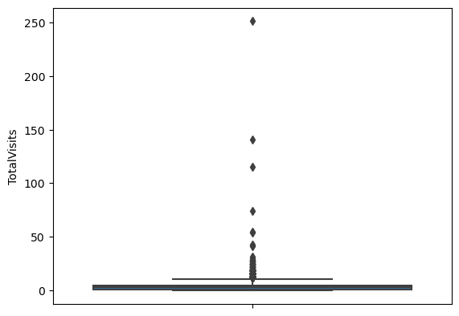
There are only 10 observations for which value is more than 30. So, those records are considered as an outliers and can change the predictions significantly in the model. So, those records are dropped.

Slide 30
Page Views Per Visit
Quantile | Value
90 | 5
95 | 6
99 | 9
99.5 | 11
99.9 | 14
99.95 | 15
Maximum number of Pages is 24 and 75% quantile value is 3 only. So, there is need to check if progress is quite sharp or gradual by getting different quantiles and using boxplots.
Parameter | Value
Count | 9019.000000
Mean | 2.359522
Std | 2.083752
Min | 0.000000
25% | 1.000000
50% | 2.000000
75% | 3.000000
Max | 24.000000

Slide 31
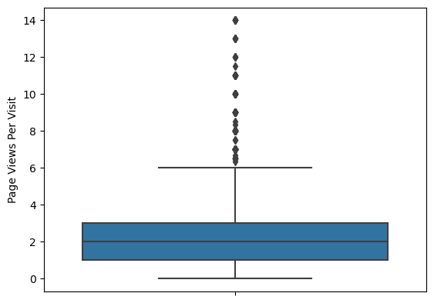
There are only 9 observations for which page views per visit value is more than 14. So, those records are outliers which could create issue in scaling and can be dropped.

Slide 32
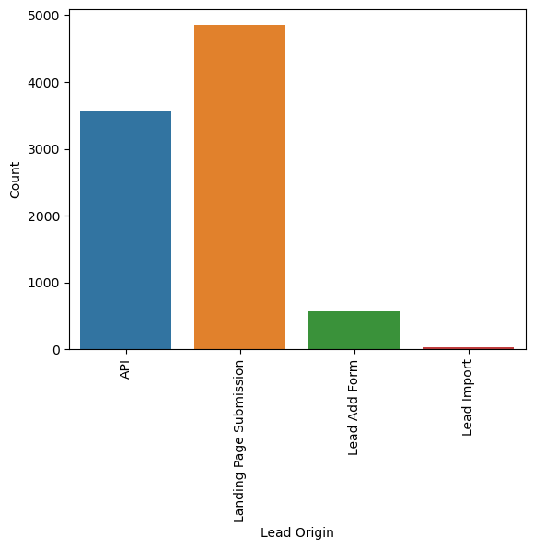
Univariate Analysis - Lead Origin
For more number of persons, origin of leas is through Landing page submission.
Different values and their counts for Lead Origin row is as below:
Value | Count
Landing Page Submission | 4886
API | 3580
Lead Add Form | 718
Lead Import | 55

Slide 33
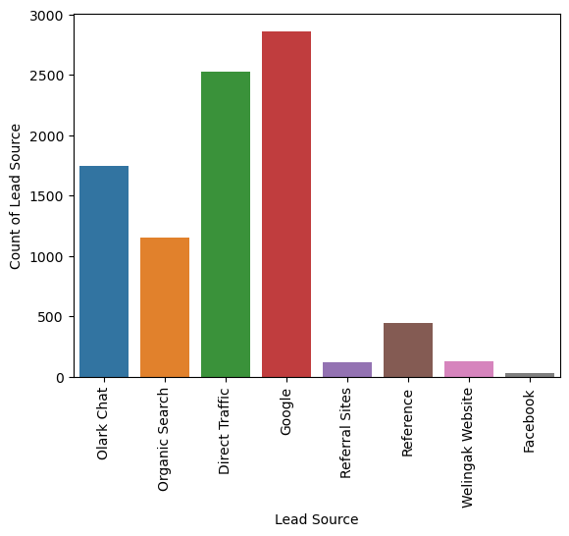
Lead Source
Google is the Lead Source for more number of users.

Slide 34
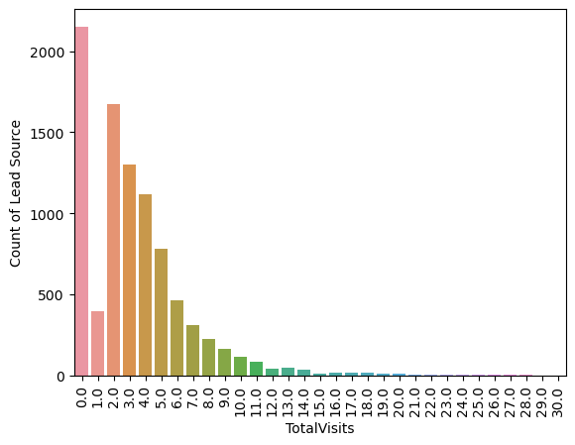
TotalVisits
For most of the users, number of total visits is between 0 to 9.

Slide 35
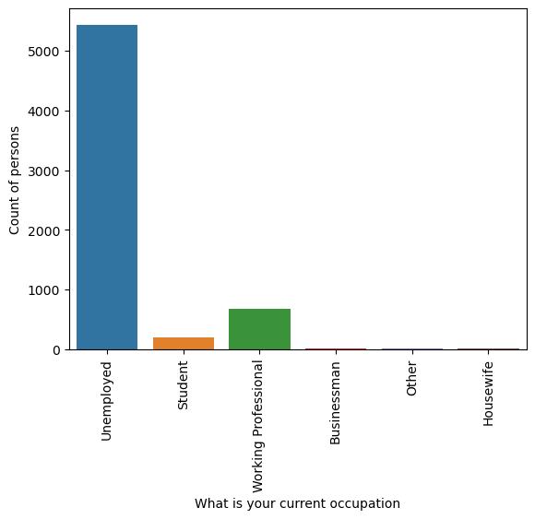
What is your current occupation
More number of people are unemployed and there are very few businessman and housewife in the given dataset.

Slide 36
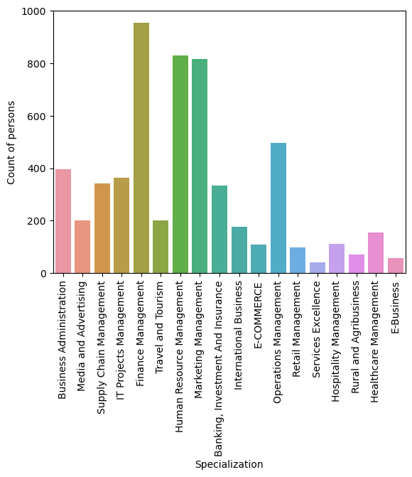
Specialization
More number of people are from Finance or Human Resource or Marketing management.

Slide 37
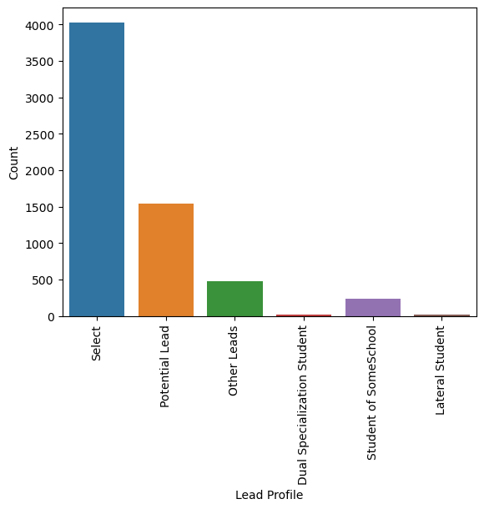
Lead Profile
There are many users for whom Lead Profile is not determined. There are very few lateral students and students with dual specialization.

Slide 38
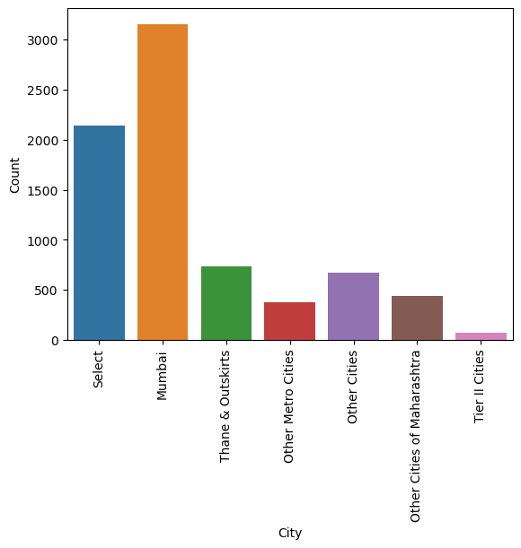
City
More number of users belongs to Mumbai city. And there are least number of users for Tier II cities.

Slide 39
A free copy of Mastering The Interview
This column has good balance of ‘Yes’ and ‘No’ values. So, this column could be very significant for the analysis.
Value | Count
No | 6180
Yes | 2879

Slide 40
Bivariate Analysis
It is divided into 2 parts:
1) Categorical – Target (Categorical) variable
2) Numerical – Target (Categorical) variable

Slide 41
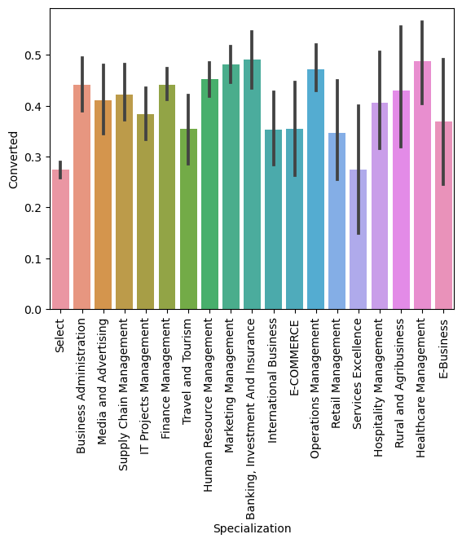
Specialization v/s Converted
After replacing the null value with ‘Select’, it is clear that person who hasn’t specified his/her Specialization has low chance of conversion. So, it may not be the case of missing value at random.
So, despite having around 36% missing value, this column is not deleted.

Slide 42
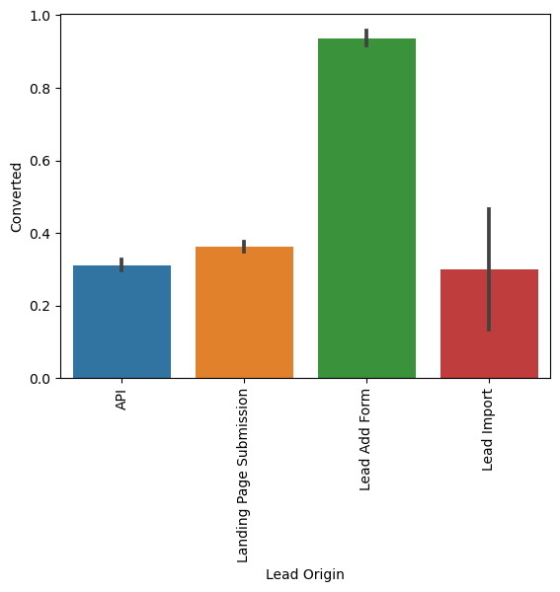
Lead Origin v/s Converted
When Lead origin is “Lead Add Form” there is very high chance of conversion, which is close to 93%. So, this variable maybe given more importance while building the model.

Slide 43
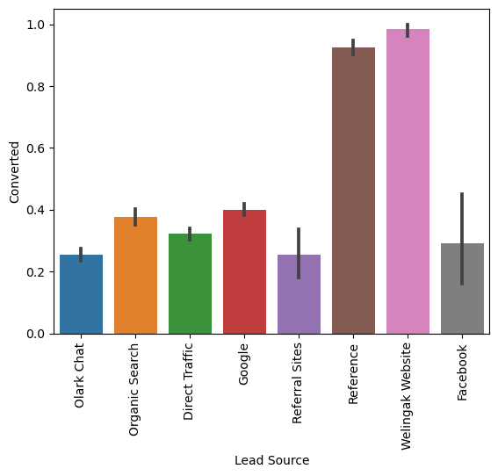
Lead Source v/s Converted
There is very high percentage of conversion rate when source of leas is either through reference or through Welingak website.

Slide 44
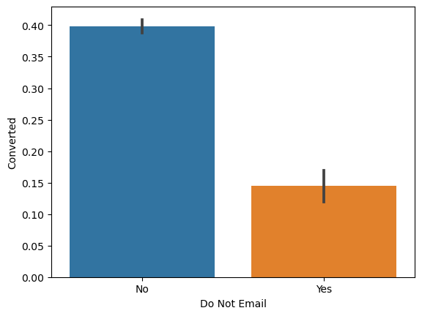
Do Not Email v/s Converted
Person who doesn’t opt for do not email has higher conversion rate compared to person who choose not to receive email which seems logical.

Slide 45
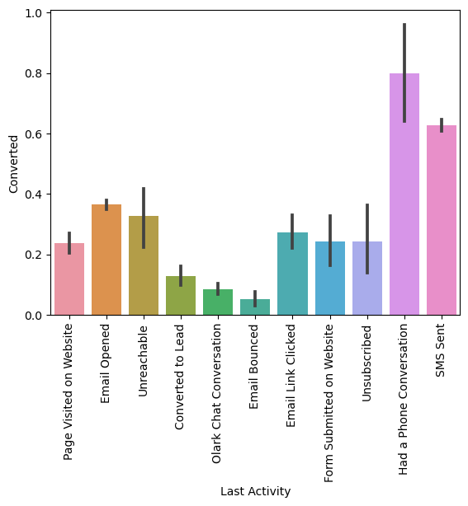
Last Activity v/s Converted
When user had a phone conversation as last activity, then there is very high chance that lead is converted and on the other hand, when email is bounced, then there is very low chance of conversion.

Slide 46
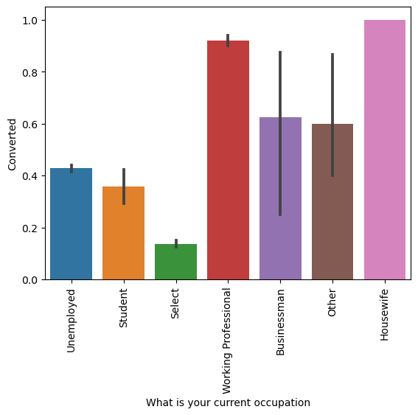
What is your current occupation v/s Converted
There are around 29% missing values, which is replaced with ‘Select’ to check conversion rate for missing values.
It is clear from the mean values, that when detail of current occupation is missing, there is very low chance of conversion to lead. For housewife and working professional, conversion chance is very high.

Slide 47
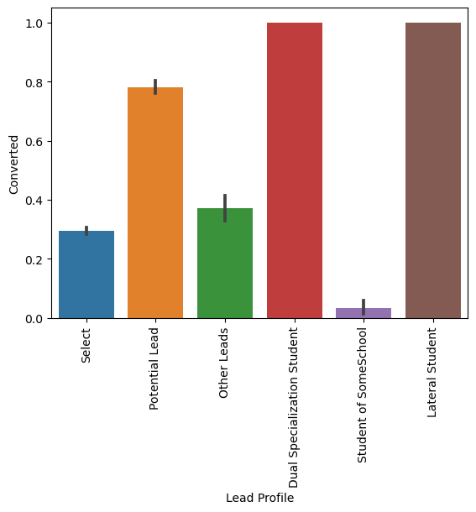
Lead Profile v/s Converted
There are around 74% missing values, when all null values are replaced with ‘Select’.
But other 26% value can provide more useful information because for dual specialization and lateral student, conversion rate is 100%. And for student of some school. Conversion rate is very low.

Slide 48
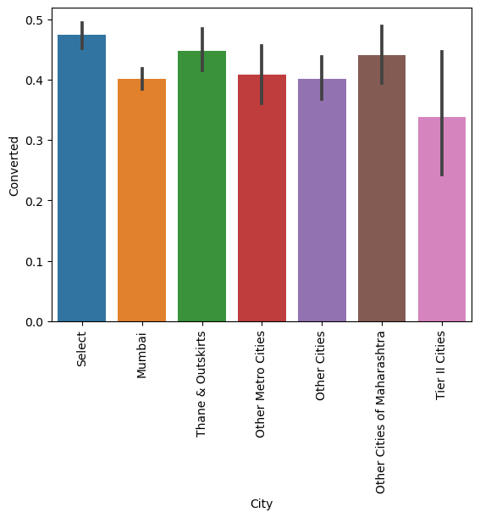
City v/s Converted
It seems that value of city doesn’t make that much difference in terms of conversion rate, but it is still kept in the dataset.

Slide 49
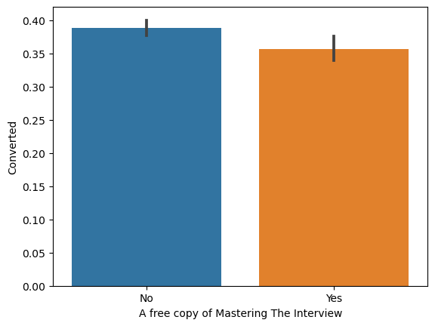
A free copy of mastering The Interview v/s Converted
There is not much difference in conversion rate based on whether free copy of mastering interview value is ‘Yes’ or ‘No’

Slide 50
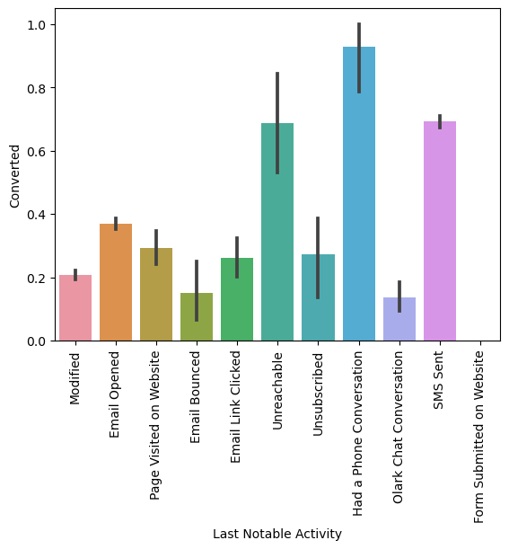
Last Notable Activity v/s Converted
In case of having last notable activity as having a phone conversation or sending SMS, conversion rate is high.

Slide 51
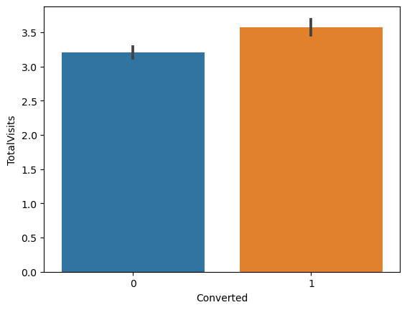
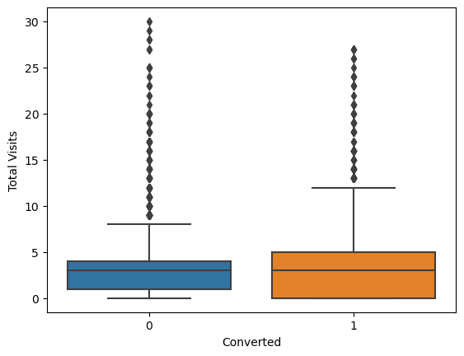
Numerical – Target (TotalVisits v/s Converted)
There is not huge difference in average value of total visits whether lead is converted or not. Whereas median is same in both case with slight difference in box plot.

Slide 52
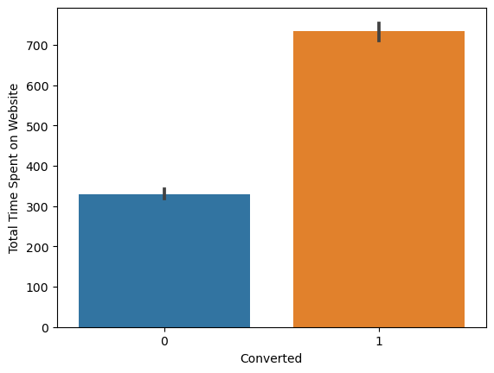
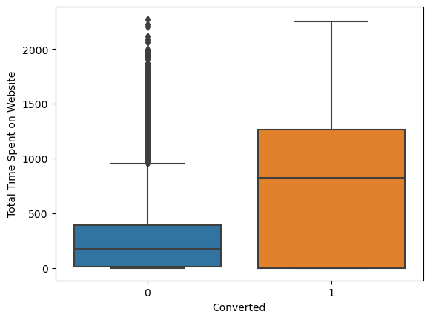
Total Time Spent on Website v/s Converted
Average amount of total time spent on website is very high when lead is converted successfully compared to non-conversion of the lead.

Slide 53
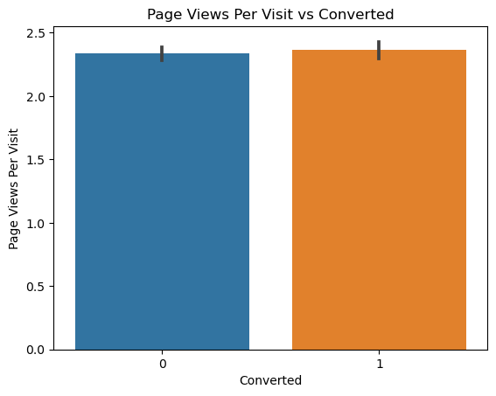
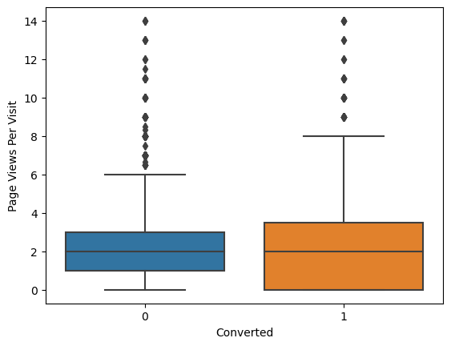
Page Views Per Visit v/s Converted
Median is same and average of Page Views Per Visit is also very similar for both converted and non-converted. There isn’t much difference in boxplot of both as well.

Slide 54
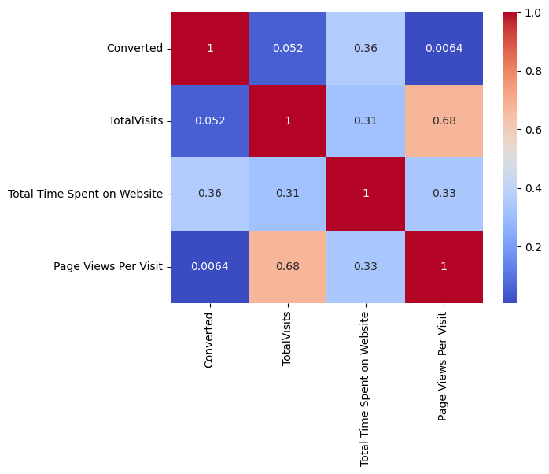
Multivariate Analysis
Correlation matrix
There is high correlation between Page Views Per Visit and TotalVisits.

Slide 55
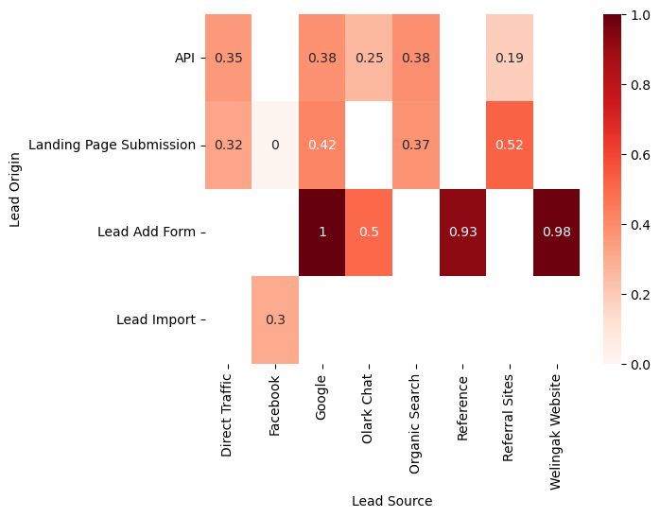
3 Variable correlations – Lead Origin and Lead Source v/s Converted
There is 100% conversion, when Origin of lead is through Lead Add Form and Source of Lead is Google.

Slide 56
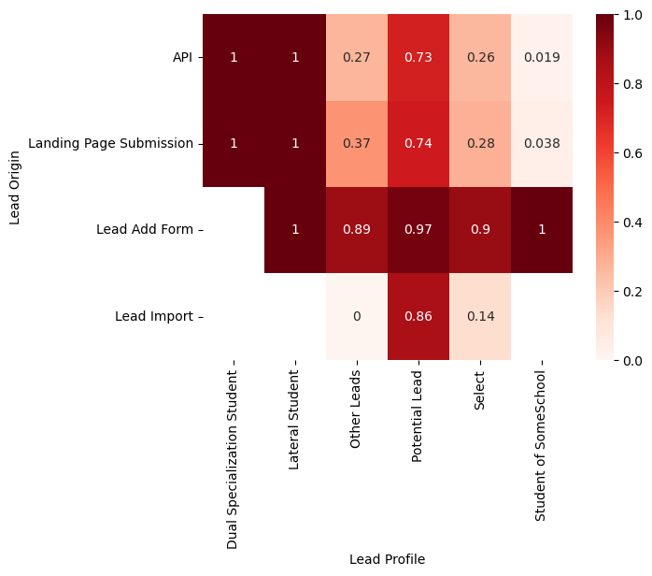
Lead Origin and Lead Profile v/s Converted
For Dual Specialization student and lateral students, conversion rate is 100%. Conversion rate is also high when lead origin is lead add form.

Slide 57
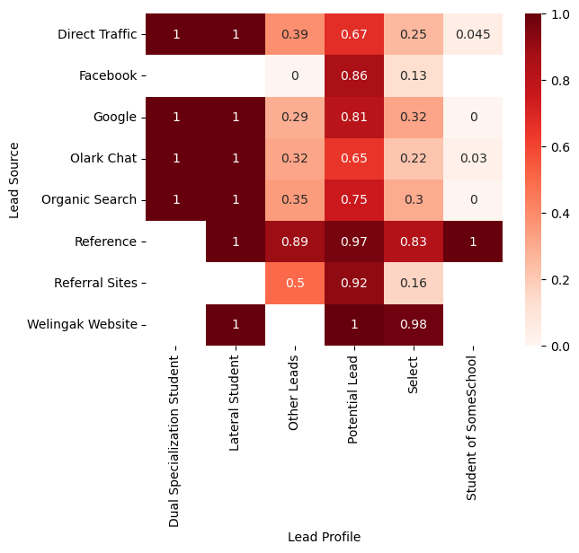
Lead Source and Lead Profile v/s Converted
Conversion rate is 100% for Dual Specialization students and lateral students. When source of lead is through reference or Welingak website, conversion rate is very high. There is 0% conversion rate for student of some school when source of lead is through organic search.

Slide 58
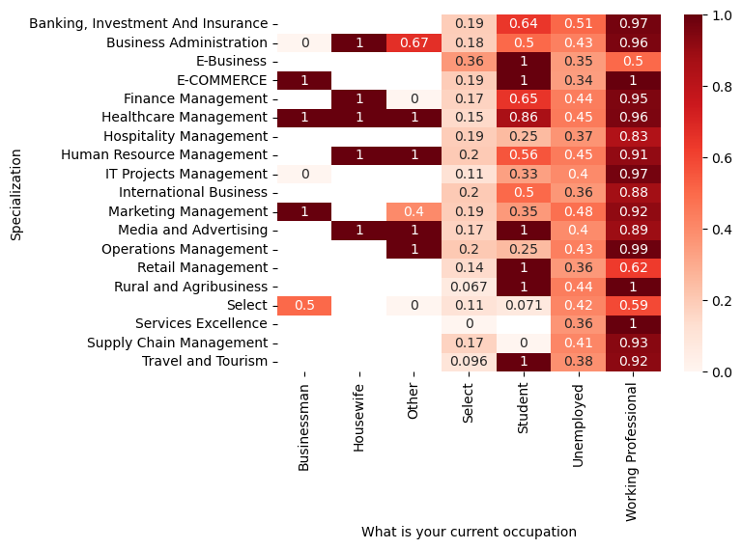
Specialization and What is your current occupation v/v Converted
Conversion rate is very low when occupation is ‘Select’ means occupation is not declared by user. And for working professional, generally conversion rate is high.

Slide 59
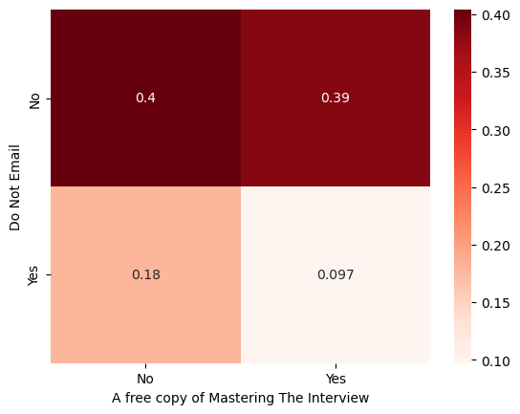
Do Not Email and A free copy of Mastering The Interview v/s Converted
When user preferred not receive Email and also has free copy of mastering the interview, then conversion rate is low.

Slide 60
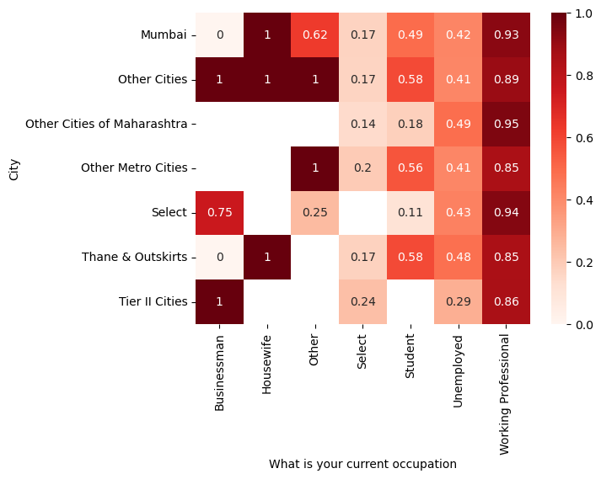
City and What is your current occupation v/s Converted
For working professional, generally the conversion rate is higher. And when occupation is ‘Select’ which means occupation is nod declated, then conversion rate is very low.

Slide 61
3) Pre-processing the data for Model Building

Slide 62
3) Pre-processing the data for Model Building
It id divided into 3 parts:
1) Creating Dummy Variables for Categorical Columns
2) Splitting data into train and test set
3) Scaling of Data

Slide 63
Creating Dummy Variables for Categorical Columns
For binary columns like ‘Do Not Email’ and ‘A free of Mastering The Interview” value ‘Yes’ is converted to 1 and value ‘No’ is converted to 0.
For columns ‘Last Activity’, ‘Lead Source’, ‘Lead Origin’, ‘Last Notable Activity’ dummy variables are created with drop_first = True
For other categorical columns ‘Specialization’, ‘What is your current occupation’, ‘Lead Profile’, ‘City’ after creating dummy variables, column with value ‘Select’ is deleted

Slide 64
Splitting data into train and test set
Data is divided into train and test set with 70 %– 30% ratio, which means 70% data is used for training and 30% data is used for testing.
In variable y_train and y_test, Converted column from the dataset is used. Whereas, in X_train and X_test, all the other columns are used.

Slide 65
Scaling of Data
MinMaxScaler is used for scaling the data from sklearn.
On training set, fit_transform() method is used whereas on test set, transform() method is used.

Slide 66
4) Building the Model

Slide 67
LogisticRegression() class is used with automated RFE for building the model
Earlier, the model is build with high number of features to get idea about which parameter is important for building the model.

Slide 68
Model – 1: With 20 features
With this model, there are many features for which p-value is very high (Close to 1)
Log-likelihood value is -2386.2 for this model
So, the next model is tried with less number of features (15)

Slide 69
Model – 2: With 15 features
There still few features for which p-value is high. So, those features are dropped one-by-one to check the further models.
Log-likelihood value is -2478.0 for this model, which is high compared to the model with high number of features
So, the next model is tried after dropping occupation_Housewife column

Slide 70
Model – 3: With dropping occupation_Housewife column
There still few features for which p-value is high. So, those features are dropped one-by-one to check the further models.
Log-likelihood value is –2481.9 for this model, which is high compared to the model with high number of features
So, the next model is tried after dropping Last Activity_Had a Phone Conversation column. Because there is also one column Last Notable Activity_Had a Phone Conversation, which looks similar to this one.

Slide 71
Model – 4: With dropping Last Notable Activity_Had a Phone Conversation column
There still 2 features (Lead Profile_Lateral Student and Lead Profile_Dual Specialization Student) for which p-value is high. So, those features are dropped one-by-one to check the further models.
Log-likelihood value is –2485.6 for this model, which is higher compared to the model with high number of features
So, the next model is tried after dropping Lead Profile_Lateral Student

Slide 72
Model - 5: After dropping Lead Profile_Lateral Student column
In this model, there is only 1 feature Lead Profile_Dual Specialization Student for which p-value is high.
In the next model, Lead Profile_Dual Specialization Student is dropped.
Log-likelihood value is –2493.0 for this model, which is high compared to the model with higher number of features

Slide 73
Model – 6: Final Model (After dropping Lead Profile_Dual Speclization Student)
P-values for all the features are below 0.05 in this model.
Log-likelihood value is –2505.9 for this model
Next, Variance Inflation Factor (VIF) is used for checking multi-collinearity present in the model

Slide 74
VIF of Final Model and Selected Features
Features | VIF
Total Time Spent on Website | 1.91
TotalVisits | 1.78
Lead Origin_Lead Add Form | 1.64
Last Activity_SMS Sent | 1.44
Lead Profile_Potential Lead | 1.40
Lead Source_Welingak Website | 1.39
occupation_Working Professional | 1.25
Do Not Email | 1.06
Lead Source_Olark Chat | 1.05
Lead Profile_Student of SomeSchool | 1.03
Last Activity_Had a Phone Conversation | 1.01

Slide 75
VIF for all the features should be less than 5. And for our model, VIF value for all the features is less than 2.
As for all the feature in this model, p-value is less than 0.5 and VIF is less than 5, it is selected as final model.

Slide 76
Step – 5: Evaluating the Model on the Training Set

Slide 77
Different evaluation Measures used
Accuracy
Specificity
Sensitivity
Precision
Recall
F1_score

Slide 78
Checking the model with cut-off value 0.5 for prediction
Various evaluating metrices are as below with this cut-off:
Measure | Value
Accuracy | 0.8201267828843106
Specificity | 0.9061621068780363
Sensitivity | 0.6798666110879533
Precision | 0.8163163163163163
Recall | 0.6798666110879533
F1_score | 0.741869456447578

Slide 79
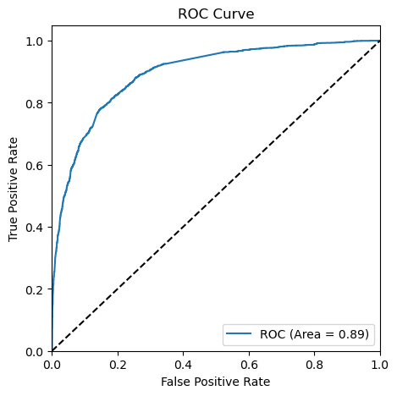
ROC Curve
Area under the ROC curve is 0.89 which is really good.

Slide 80
Value of evaluation metrics with different cut-offs
Cut-off | Accuracy | Sensitivity | Specificity | Precision | Recall
0.1 | 0.654511 | 0.968354 | 0.465583 | 0.521709 | 0.968354
0.2 | 0.768036 | 0.897046 | 0.690373 | 0.635575 | 0.897046
0.3 | 0.805137 | 0.837975 | 0.785370 | 0.701519 | 0.837975
0.4 | 0.822420 | 0.781013 | 0.847346 | 0.754894 | 0.781013
0.5 | 0.815285 | 0.681857 | 0.895606 | 0.797237 | 0.681857
0.6 | 0.808942 | 0.617300 | 0.924308 | 0.830778 | 0.617300
0.7 | 0.795148 | 0.533333 | 0.952756 | 0.871724 | 0.533333
0.8 | 0.772316 | 0.435021 | 0.975362 | 0.914007 | 0.435021
0.9 | 0.733471 | 0.310970 | 0.987808 | 0.938854 | 0.310970

Slide 81
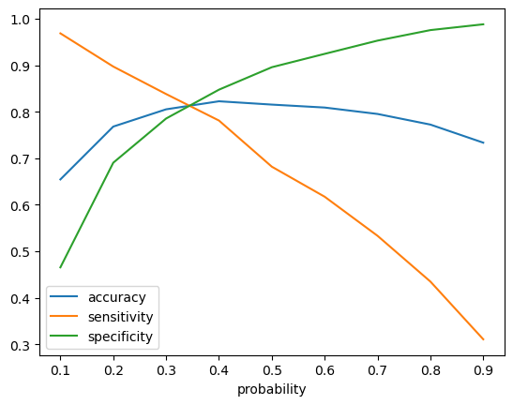
Finding optimal value of cut-off
With accuracy, sensitivity and specificity graph, optimal value of threshold seems close to 0.35.

Slide 82
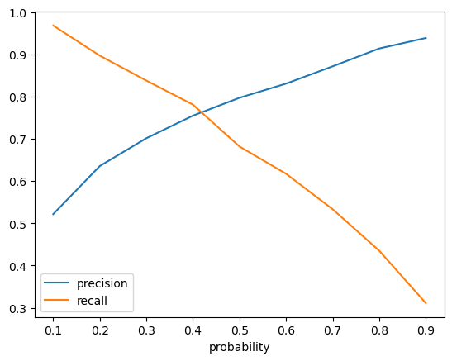
Finding optimal value of cut-off
With precision and recall graph, optimal value of threshold seems close to 0.42

Slide 83
Making prediction with cut-off (0.35)
With cut-off of 0.35, accuracy is close to 81%, whereas value of precision is close to 73% and recall is close to 81%. Value of specificity is close to 82%.
Measure | Value
Accuracy | 0.8256735340729001
Specificity | 0.8578368703656354
Sensitivity | 0.7732388495206336
Precision | 0.7693902944836167
Recall | 0.7732388495206336
F1_score | 0.7713097713097713

Slide 84
Making prediction with cut-off (0.42)
With cut-off of 0.42, accuracy is close to 82%, whereas value of precision and recall is almost same (Close to 77%). And specificity is also very high which is close to 86%. So, it is chosen as final cut-off.
Various measures are as below:
Measure | Value
Accuracy | 0.8256735340729001
Specificity | 0.8578368703656354
Sensitivity | 0.7732388495206336
Precision | 0.7693902944836167
Recall | 0.7732388495206336
F1_score | 0.7713097713097713

Slide 85
Step – 6: Making predictions on the test set

Slide 86
Scaling and transforming features
Numerical features TotalVisits, Total Time Spent on Website and page Views Per Visit is transformed with same MinMaxScaler() that is applied on training set

Slide 87
Prediction on the Test Set (0.42)
On the test set as well, model is performer quite well.
Measure | Value
Accuracy | 0.8125693160813309
Specificity | 0.8421985815602837
Sensitivity | 0.7630799605133267
Precision | 0.7432692307692308
Recall | 0.7630799605133267
F1_score | 0.7530443253774963

Slide 88
Comparison of results on Train and Test Set
Train Set
Measure | Value
Accuracy | 0.8256735340729001
Specificity | 0.8578368703656354
Sensitivity | 0.7732388495206336
Precision | 0.7693902944836167
Recall | 0.7732388495206336
F1_score | 0.7713097713097713
Test Set
Measure | Value
Accuracy | 0.8125693160813309
Specificity | 0.8421985815602837
Sensitivity | 0.7630799605133267
Precision | 0.7432692307692308
Recall | 0.7630799605133267
F1_score | 0.7530443253774963

